Slide 1
Semester project presentation
1. Introduction
Extending Dynamic Structure in Memory Network for Response Generation
Supervisor: Mi Fei
Director: Prof .Boi Faltings
Myself: André Cibils
Plan:
1. Introduction
2. DMN
3. Modifications & implementation details
4. Results
5. Questions
Extending Dynamic Structure in Memory Network for Response Generation
Notes:
Goal of the project
Modify and extend the memory structure of dynamic memory network to produce multiple word answer

Slide 2
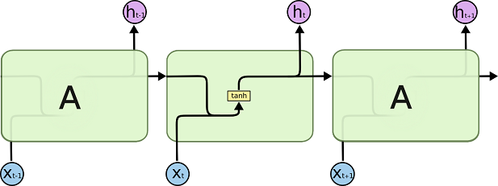
Dynamic Memory Network
4 parts:
  Input module
  Question module
  Episodic memory module
  Answer module
Neural network based framework
Internal memory representation (memory vector m)
Uses lot of Gated Recurrent Units
End-to-end
todo add eq
Notes:
Input module encode the input by using word embedding and GRU: #Tc facts representation, one for each sentence, or if only one sentence, one fact repr for each word
Question module encode the queston using the same mechanism that the input m. Only one q representation
Episodic module iterates over the fact repr and update the mem vec
Answer module decodes the final mem vec
GRU: no gradient vanish, learning via back prog through time.
Model is end-to-end

Slide 3
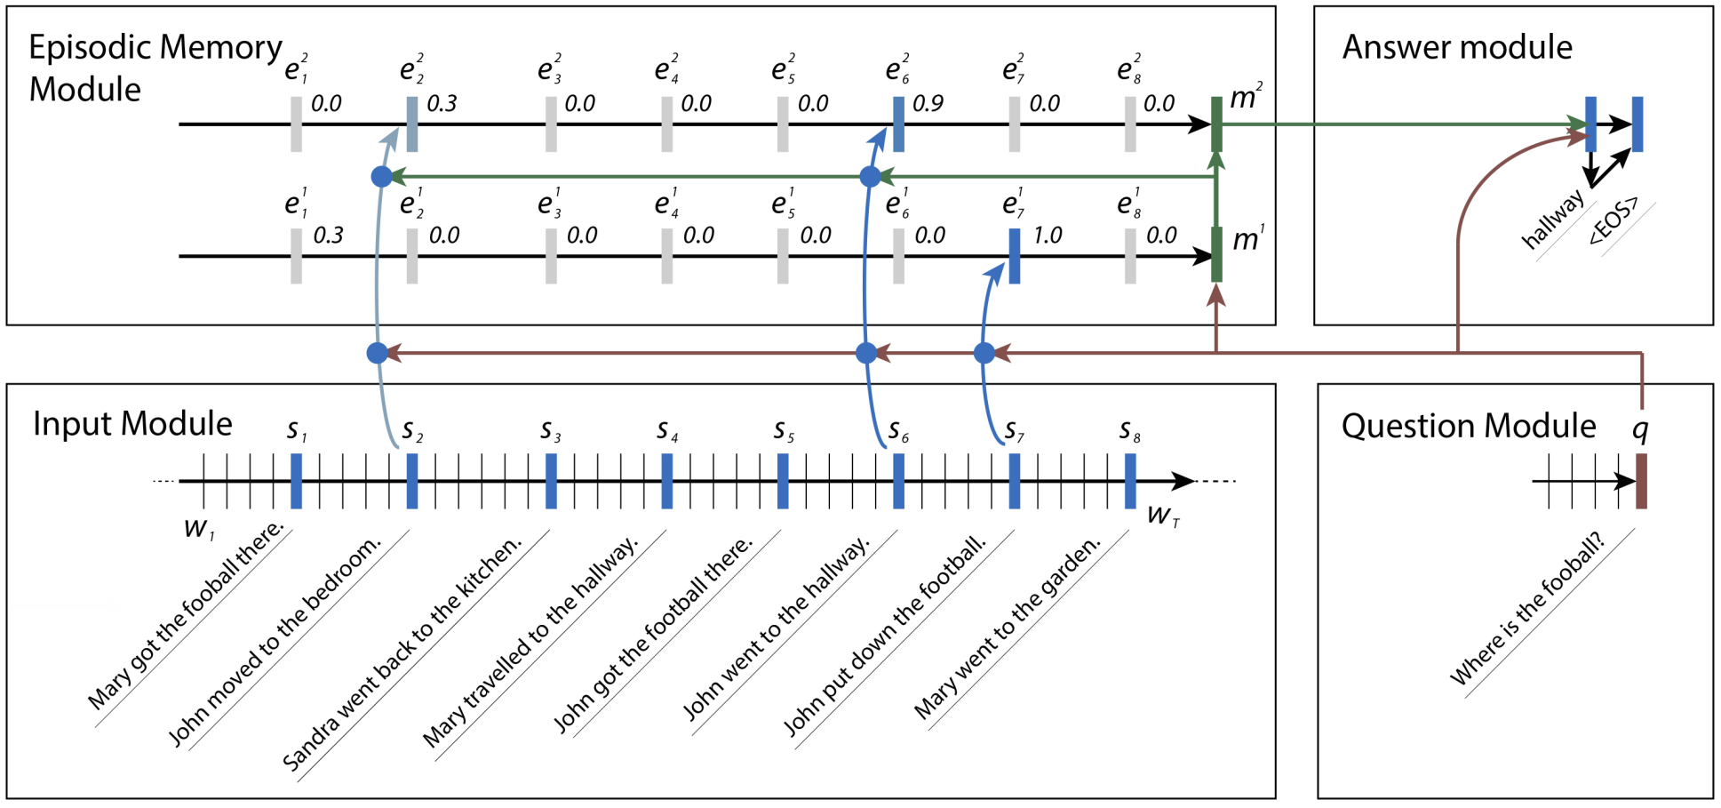
Dynamic Memory Network
1. Introduction
Notes:
Main idea:
-input create TC fact repre
Answer mod uses q from question mod
Epmem mod iterates over fact repr to create episodes e from which m is compute

Slide 4
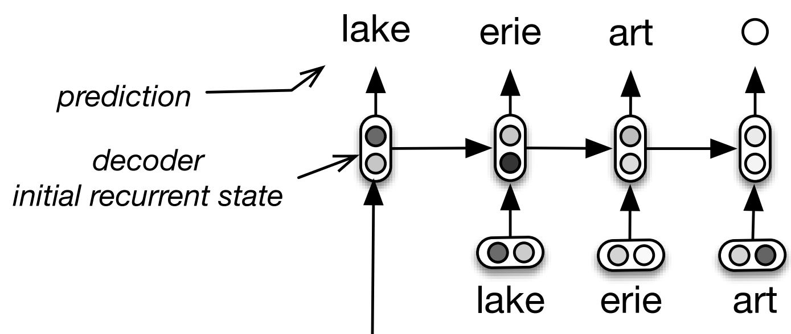
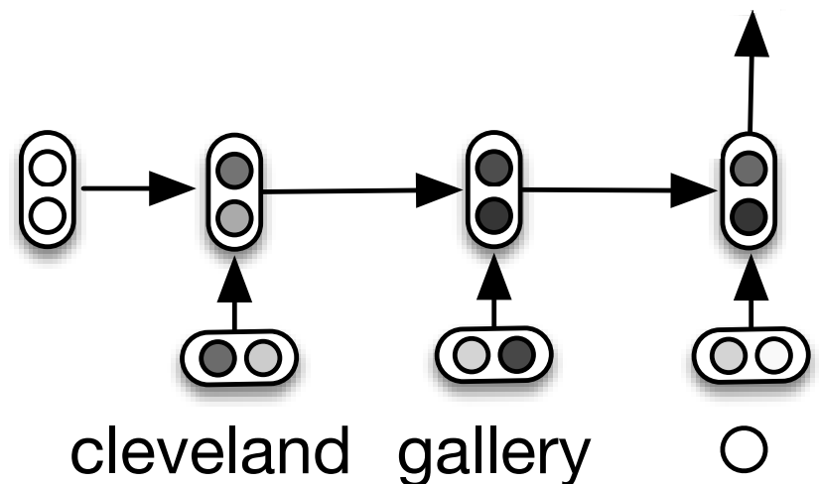
Modification 1
2. Modifications
Encoder-Decoder architecture
Idea: see the answer module as a decoder
Can now produce (fixed & limited) number of words.
Notes:
Loss calculation is obviously modified as well
We can learn the model to produce <eos> char, so having a fixed nbr of words is not a problem
Encoder Decoder arch is used in auto-completion task, query reformulation. One RNN encode the previous query (context-aware and order-sensitive), one RNN decode it to generate new words
We consider the mem vec as the encoding needed for the decoder, so the answer module is now a decoder

Slide 5
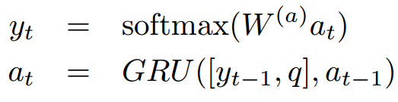
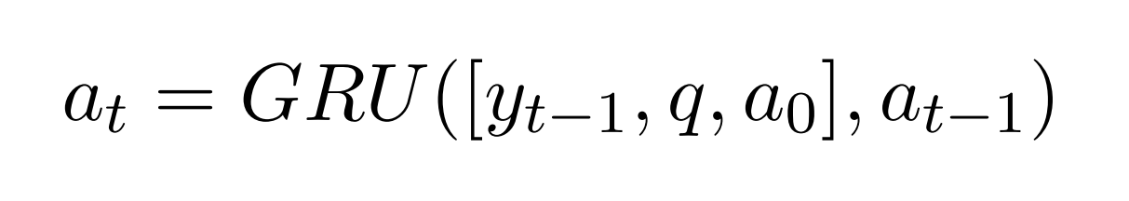
Modification 2
2. Modifications
Modification of the answer module.
Same idea as the encoder-decoder modification
Added the original memory vector as input
Notes:
Lot of info loss as the decoder updates its internal memory
Idea is to simplify its task by giving it the original mem vec at each ite

Slide 6
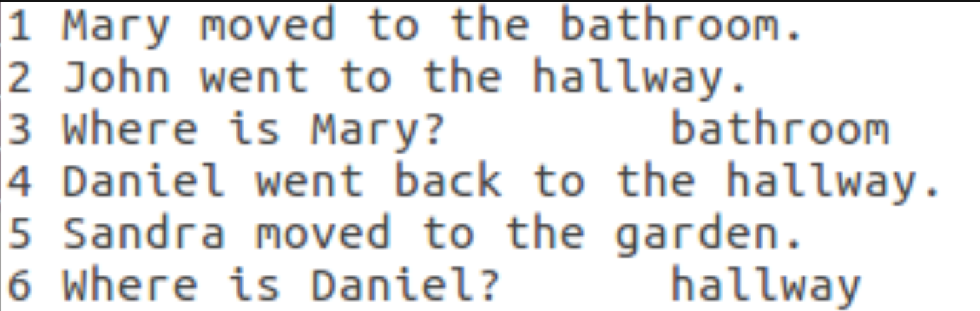
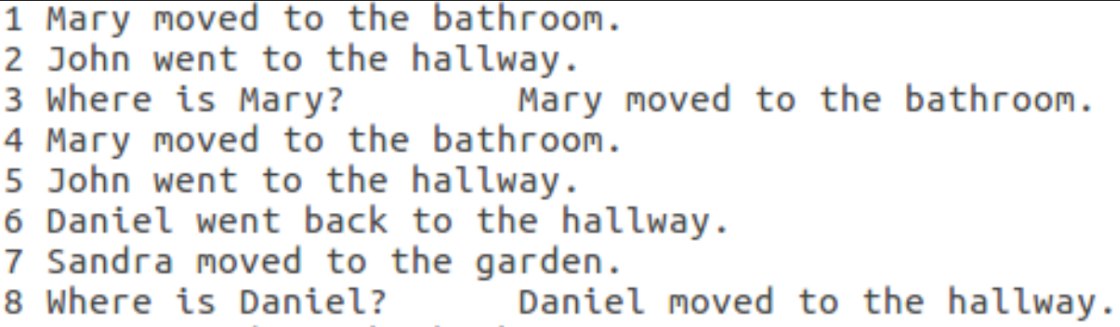
Implementation details
Modification of the bAbi data set
Simple sentences as answers
TODO Add glove, training procedure
then results
Answers always have the same architecture
<Subject> moved to the <Place>. (ex: "Marie moved to the office.")

Slide 7
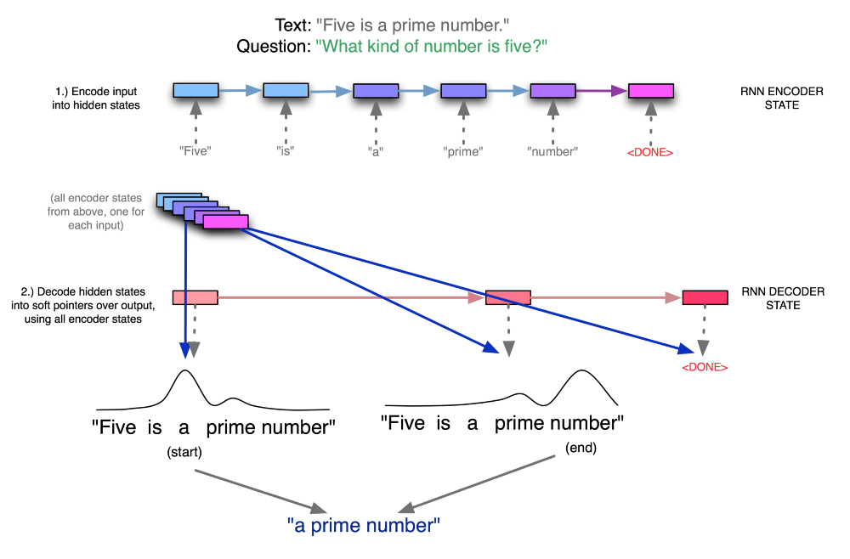
Pointer Nets - Quickly

Slide 8
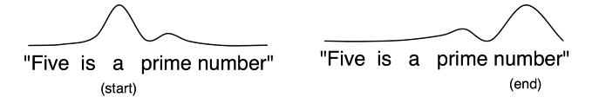
Modification 3
2. Modifications
Pointer nets modification
Hypothesis: the answer is in the text
The goal is to find where it is, i.e. Produce a start and end idx
Uses the memory vector and the fact representations, or the hidden state of the episode update mechanism to generate indices
Notes:
The model must produce two index: one giving the start of the answer, one giving the end of the answer

Slide 9
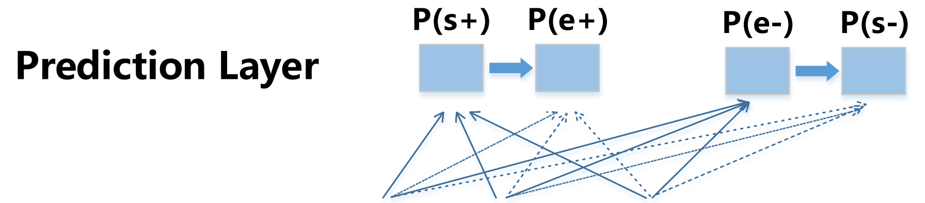
Implementation details
SQuAD data set – complex and diverse
Two-directional prediction: produce start idx, then use it to produce end idx & redo it the other way, then merge
Notes:
Explain quickely modification to the bAbi Dataset
Explain SQuAD data set. Why SQuAD?
L2??
Adam loss??

Slide 10
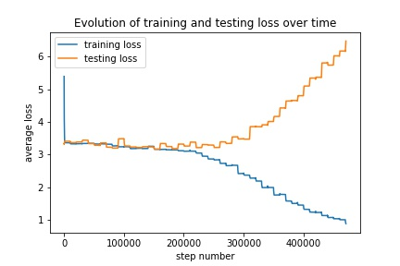
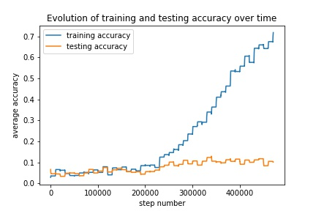
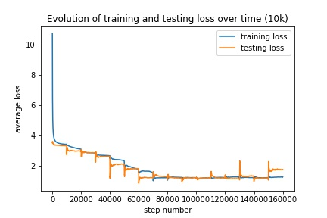
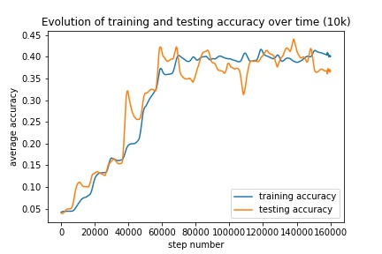
Notes:
Explain the graphs & the correlation between the two: low accuracy & low loss => model got the easy part but fails to get the Subject & the Place

Slide 11
Mod 1 results
High tendencie to overfit
However, with a lot of data, seems to work
Models focus on learning the easy part of the sentence
<Subject> went to the <Place>. (ex: "Marie went to the office.")
Notes:
Explain why it fails
-> lot of information is loss during the decoding
-> loss calculation is equivalent for each word, but it's logical (why force the model to learn specific parts?)

Slide 12
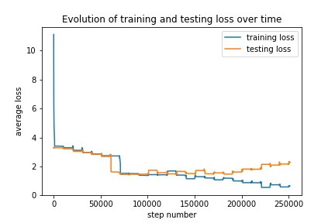
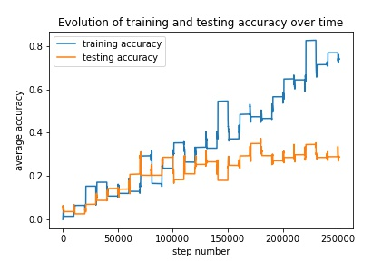
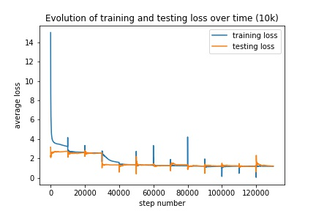
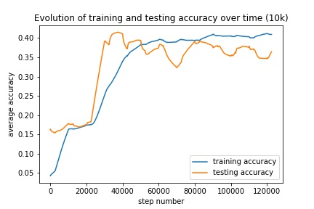

Slide 13
Mod 2 results
Slightly better
Not good enough
With a small dataset, accuracy is better!
Modification 1
Modification 2
Notes:
Explain the graph, again
How is it better?
Why is it better?

Slide 14
Mod 3 results
Does not work at all
TODO ADD PIC
Notes:
Why?
How to fix it?
What does it mean?

Slide 15
Conclusion
TODO

Slide 16
Referencs
[1] Ask Me Anything: Dynamic Memory Network for Question Answering, 5 Mar 2016
[2] A Hierarchical Recurrent Encoder-Decoder for Generative Context-Aware Query Suggestion, 8 Jul 2015
[3] Exploring Question Understabdubg abd Adaptation in Neural-Network-Based Question Answering, 25 Mar 2017

Slide 17
Questions?
5. Questions

Slide 18
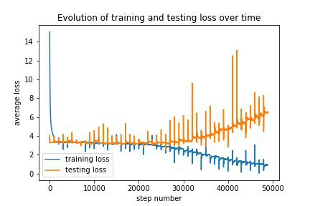
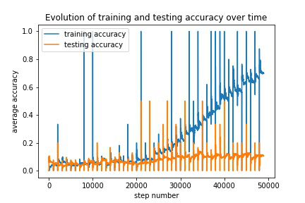
Dataset – Results
3. Results
With a small dataset, results are not that good.
if the model gets the answer perfectly, accuracy is set to 1, else to 0.
Notes:
(explain the data!)
It takes some time! For a simple task like this one.
Overfitting occurs. This is trained with 1000 example, but there is more data availabe
Accuracy is =1 if the model is completly right, else it is 0: hard mesure
Hopefully the big dataset will get better results

Slide 19
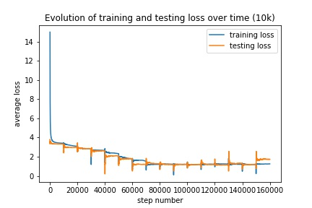
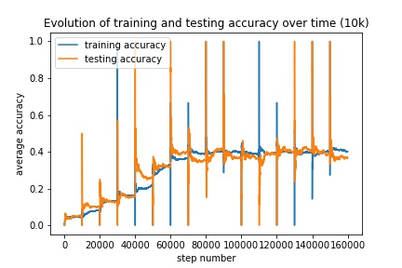
Dataset – Results
3. Results
With a big dataset, results seems better.
Notes:
It takes a lot of time! For a simple task like this one.
Here, no overfitting occurs yet. I suspect that if the model runs for too long, overfitting will occur.
Results are better but not good (40% acc, 100% on base))
The goal is to try with an even bigger dataset to see if the average accuracy still improve (memory issue though)
I need to think of possible modification of the model as well

